Slide 1

Enhancing Operational Efficiency in a Multispecialty Hospital
Name: Prawit Pongpipat (Business Analyst)
Date: June 30, 2025

Slide 2
Table of Contents
Executive Summary
Introduction
Business Objectives
Methodology
Requirements Gathering (BRD and RTM)
Stakeholder Analysis and Engagement Plan
Scope Management Plan
Data Analysis
Data Visualization
Process Mapping
Risk Assessment Plan
Risk Mitigation Plan
Findings and Recommendations
Key Findings
Key Recommendations
Conclusion
Appendix

Slide 3
Executive Summary
Problem:
The hospital faces multiple operational issues that affect service quality and stakeholder satisfaction
Key insights:
System glitches and scheduling conflicts affected operational efficiency
Delay appointment system and long wait time for patients affected service quality
Recommended actions:
Integrate record and scheduling system
Improvements to patient and doctor scheduling
Enhancement of overall operational efficiency

Slide 4
Introduction
Opportunity:
1. Possible area to improve the system
2. Enough resources and supporting from stakeholders
Approach:
1. Analyze the core issues (e.g., scheduling conflicts, etc.)
2. Plan the detailed solutions
Key questions/hypotheses:
Existing IT infrastructure is sufficient
Stakeholders are available for feedback and testing

Slide 5
Business Objectives
Integrate record and scheduling system
Enhancement of overall operational efficiency
Improve system and services core
Minimize the scheduling conflicts
Better appointment system
Better scheduling for patients and doctors

Slide 6

Methodology

Slide 7
Requirements Gathering: Business Requirement Document (BRD)
Problem statement:
• Overall appointment system and wait time for patients
• Overbooked schedules for doctors and delay
• Limited availability of nurses and essential supplies
• System glitches and scheduling conflicts
• Unintegration between current scheduling and record management systems
Key requirements to improve operational efficiency:
• Integrate record and scheduling system
• Improvements to patient and doctor scheduling
• Enhancement of overall operational efficiency

Slide 8
Requirements Gathering: Business Requirement Document (BRD)
Constraints:
• Limited IT staff availability during implementation
• Potential for ongoing service disruptions during transition
• Budget or time limitations
Acceptance criteria:
• Current scheduling and record management system must integrate
• Minimize the scheduling conflicts as low as possible
• Improve the overall appointment system
• Better scheduling for patients and doctors

Slide 9
Requirements Gathering: Requirement Traceability Matrix (RTM)
Requirement ID | Requirement description | Priority (MoSCoW) | Stakeholder(s) | Project objective | Related data file | Status
R01 | Automate appointment scheduling with conflict detection | Must Have | Administrative Staff | Reduce wait times and scheduling errors | appointment_data.csv | Approved
R02 | Provide real-time appointment notifications | Must Have | Patients | Keep patients informed and reduce no-shows | feedback_data.csv | Approved
R03 | Improve staff communication system | Should Have | Doctor and Nurses | Reduce errors and delays due to miscommunication | feedback_data.csv | Approved
R04 | Automate resource allocation system | Should Have | Nurses | Optimize resource use and reduce shortages | resource_data.csv | Approved
R05 | Design a new UI for online appointments | Could Have | IT Teams | Improve system usability and reduce complaints | resource_data.csv | Approved
R06 | Implement an online patient feedback system | Could Have | Patients | Gather faster insights to improve service quality | feedback_data.csv | Approved

Slide 10
Stakeholder Analysis and Engagement Plan
Stakeholder Name/Group | Role/Responsibility | Influence Level | Interest Level | Key Requirements | Engagement Strategy | Frequency of Interaction | Communication Method
Patients | Service Recipients | Low | High | Real-time appointment notifications, reduced wait times | Newsletters, Feedback Surveys | Monthly | Email, Surveys
Nurses | Provide healthcare for patients | Medium | High | Access to patient records | Training sessions, Direct feedback | Weekly | In-person meetings
Doctors | Diagnose and treat patients | High | High | Integrated patient info, scheduling flexibility | Regular updates, Feedback loops | Weekly | In-person meetings, Email
Administrative Staff | Manage appointments, billing, records | Medium | High | Fast data entry, validity data | Workshops, User guides | Weekly | Training, Email
Support Staff | Assist daily operations | Low | Low | Clear workflow procedures | Workshops, User guides | Monthly | Briefings, Email
IT teams | Develop and maintain system | High | Medium | System reliability, user issue tracking | Agile standups, Incident reports | Weekly | In-person /Online meeting, Email

Slide 11
Scope Management Plan
In-scope activities:
• Design and implementation of an integrated scheduling-record system
• Development of notification and feedback tools
• Appointment automation with conflict detection
• Resource allocation automation
• UI/UX enhancement of online booking
• Staff training and final deployment

Slide 12
Scope Management Plan
Out-of-scope activities:
• Hiring new medical or administrative staff
• Physical infrastructure changes
• Third-party supplier integrations

Slide 13
Scope Management Plan
Assumptions:
• Existing IT infrastructure is sufficient
• Stakeholders are available for feedback and testing
• No major policy or organizational disruptions will occur
Constraints:
• Limited staffing during project implementation
• Project must be completed within 19-20 weeks
• Fixed budget

Slide 14
Scope Management Plan
Phases in the Work Breakdown Structure (WBS):
WBS ID | Task name | Task description | Owner | Milestone/Deliverable | Estimated Duration
1.0 | Project initiation | Kick-off and planning | PM | Project Charter | 1 week
1.1 | Requirements Gathering | Collect requirements | BA / PM | BRD Completion | 1 week
1.1.1 | Stakeholder Interviews | Interview patients, doctors, nurses, and admin | BA | Interview Summary | 1 week
1.1.2 | Analyse Appointment Data | Identify scheduling inefficiencies | BA / DA | Data Analysis Report | 1 week
1.2 | System Design | Architecture and UI/UX planning | IT teams | Design Document | 2 weeks
1.3 | System Development | Build system & services | IT teams | Working Modules | 6 weeks
1.4 | Testing | Testing modules | IT teams | Test Report | 3 weeks
1.4.1 | User Acceptance Testing | Internal check for each module | IT teams | Pass Reports | 1 week
1.5 | Deployment | Final rollout to production | IT teams | Live Date | 1 week
1.6 | Training & Handover | End-user training and documentation | PM | Training Completion | 1 week
1.7 | Project Closure | Lessons learned and closeout docs | PM | Final Report | 1 week

Slide 15
Scope Management Plan
Scope change management:
Approval
• High-impact changes require owner/sponsor approval
• Low/medium changes could be approved by PM
Implementation
• Approved changes are added to the WBS and timeline
• All stakeholders are notified of updates

Slide 16
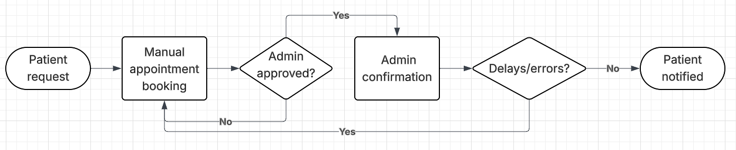
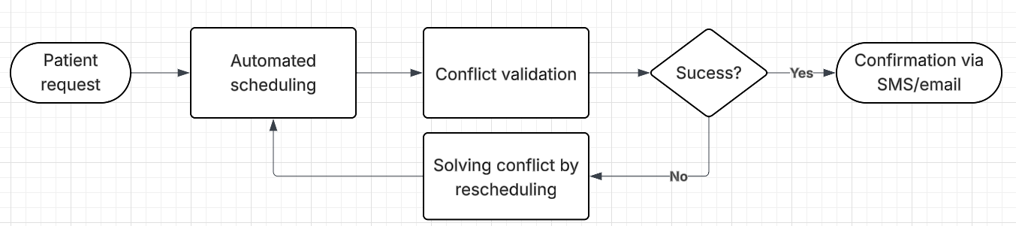
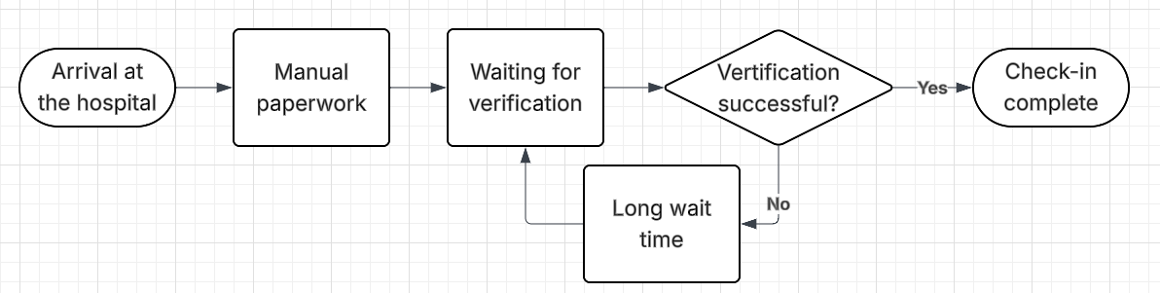
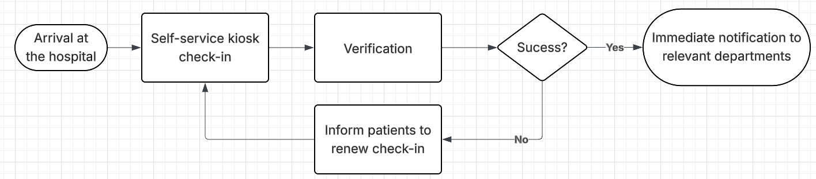
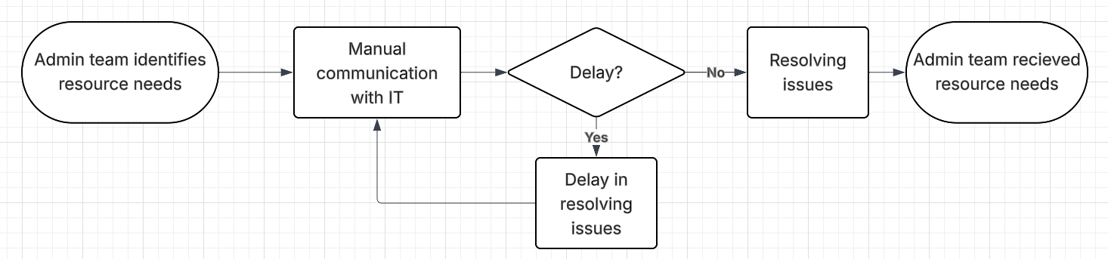
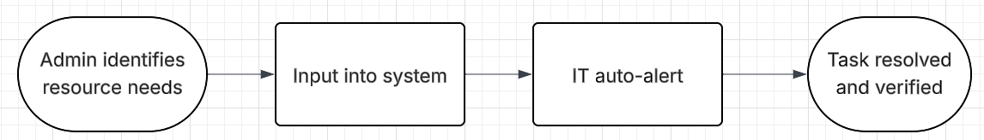
Process Mapping
Process | As-Is Model | To-Be Model
Appointment scheduling process
Patient check-in process
Interdepartmental communication

Slide 17
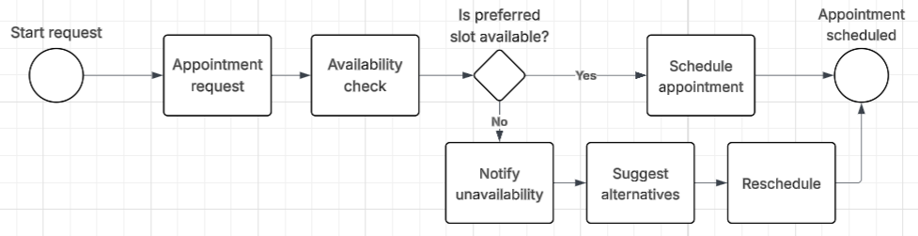
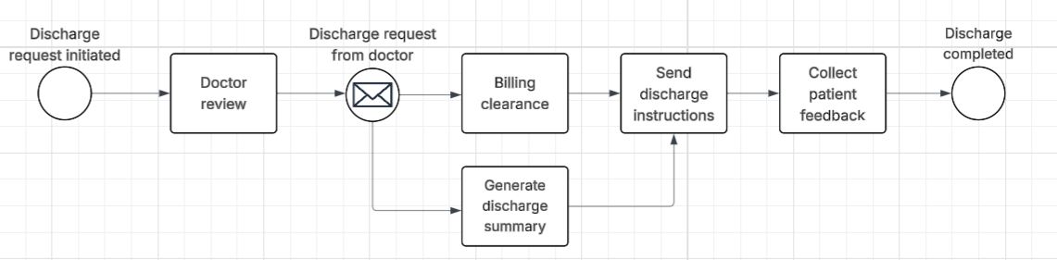
Advanced Process Mapping
Detailed workflow using the advanced BPMN model:
Patient appointment scheduling workflow
Discharge process workflow

Slide 18
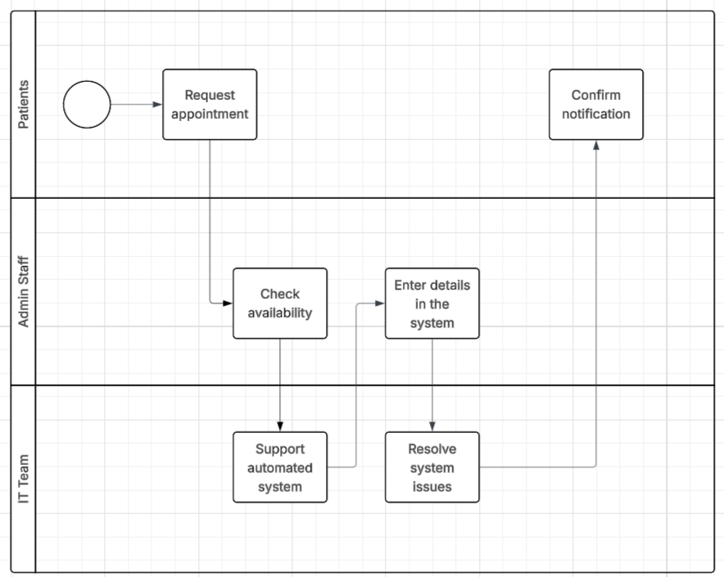
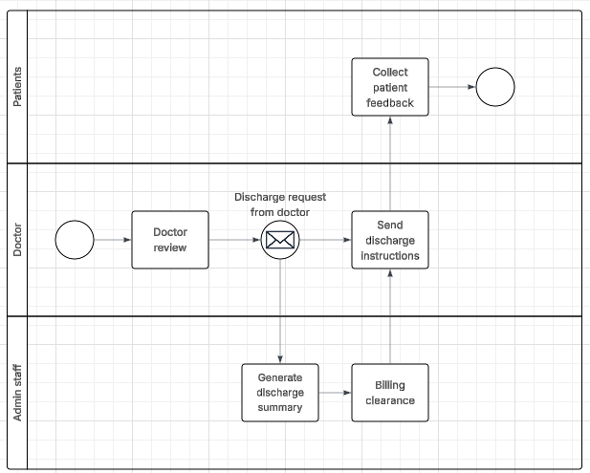
Advanced Process Mapping
Stakeholder responsibility using the Swimlane diagram:
Patient appointment scheduling workflow
Discharge process workflow

Slide 19
Data Analysis
Trends using a Pivot Table:

Slide 20
Data Analysis
Trends analyzed from the Pivot Table:

Slide 21
Data Analysis
Key insights:
Peak appointment hours (appointment_data.csv)
Peak Hours: 18:00 PM
Most department’s appointment: Cardiology
Satisfaction level (feedback_data.csv)
High (More than or equal to 5): 171
Low (Less than 5): 27
Resource bottlenecks (resource_data.csv)
Most used: Room
Least used: Nurses

Slide 22
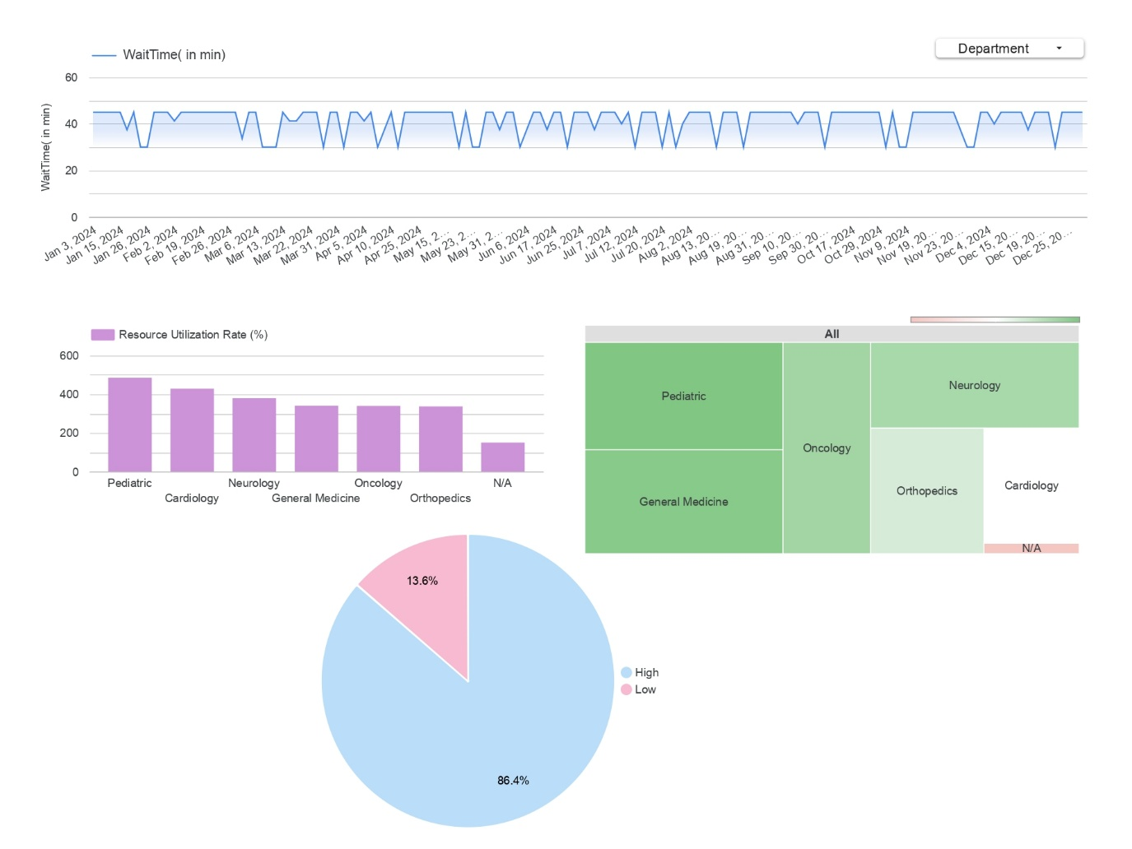
Data Visualization
Average patient wait time using a line chart:

Slide 23


Data Visualization
Bar chart highlighting overused and underutilized resources:

Slide 24
Data Visualization
Patient feedback visualized using a Pie Chart:

Slide 25
Data Visualization
Heat Map showing the efficiency of departments:

Slide 26
Risk Management Plan
Risks identified in the risk register:
Risk ID | Risk Description | Risk Category | Likelihood | Impact | Severity
R01 | Scheduling conflicts from incomplete system integration | Technical | High | High | High
R02 | System glitches that cause appointment delays/errors | Technical | Medium | High | High
R03 | Limited staff availability | Operational | Medium | Medium | Medium
R04 | Overbooked doctor schedules that cause patient dissatisfaction | Operational | High | High | High
R05 | Patients experience longer wait times during system transfer | Stakeholder | Medium | High | High
R06 | Staff resistance to new scheduling system | Stakeholder | Medium | Medium | Medium
R07 | Data breaches due to system integration | Technical | Low | High | Medium
R08 | Budget and time constraints limit project scope | Operational | Medium | Medium | Medium
R09 | Miscommunication between staff | Operational | Medium | Medium | Medium

Slide 27
Risk Management Plan
Risks categorized based on the Risk Assessment Matrix:

Slide 28
Risk Management Plan
Elements identified in the SWOT analysis:
Strengths
Weaknesses
Strong stakeholder involvement
Well-planned project scope and objectives
Access to supporting data sets and stakeholder
Limited staff availability
Potential service disruptions during transition
Manual workflows and data silos
Opportunities
Threats
System and services integration to improve scheduling
Automation potential to reduce wait times
Staff training during transition
Data security risks from integration
Resistance to adapt from staff
Budget/time constraints

Slide 29
Risk Management Plan
Key insights from the Risk Management Plan:
There are no GREEN risks
Most of risks are defined as yellow and red
There are no risks that unsolvable

Slide 30
Risk Mitigation Plan
Strategies to mitigate risks:
Risk ID | Risk Description | Risk Category | Likelihood | Impact | Severity | Mitigation Strategy
R01 | Scheduling conflicts from incomplete system integration | Technical | High | High | High | Rollout system integration as quickly as possible
R02 | System glitches that cause appointment delays/errors | Technical | Medium | High | High | Monitoring and quick fixes
R03 | Limited staff availability | Operational | Medium | Medium | Medium | Plan human & resource allocation
R04 | Overbooked doctor schedules that cause patient dissatisfaction | Operational | High | High | High | Improve scheduling and reduce overbooked
R05 | Patients experience longer wait times during system transfer | Stakeholder | Medium | High | High | Schedule upgrades during low patient time
R06 | Staff resistance to new scheduling system | Stakeholder | Medium | Medium | Medium | Provide intensive training and a guidebook
R07 | Data breaches due to system integration | Technical | Low | High | Medium | Apply strong cybersecurity measures
R08 | Budget and time constraints limit project scope | Operational | Medium | Medium | Medium | Prioritize critical features and regular progress reviews
R09 | Miscommunication between staff | Operational | Medium | Medium | Medium | Create clear communication channels

Slide 31
Risk Mitigation Plan
Factors included in the Contingency Plan:
Risk ID | Contingency Plan
R01 | If scheduling conflicts happen, deploy a temporary manual override process for scheduling while developing urgent fixes and communicate delays directly to patients and staff.
R02 | In case of system glitches, backup appointment systems (manual or alternative digital). And IT work on emergency patches and restore normal operations as soon as possible.
R03 | If staff shortage delays tasks, reassign duties to available personnel or hire outsource contractors. Communicate adjusted timelines to stakeholders carefully.
R04 | For overbooked schedules causing dissatisfaction, implement temporary appointment caps and additional patient communication. Review schedules and adjust dynamically daily.
R05 | If patient wait times increase during system upgrades, deploy additional patient support staff to manage flow, provide timely updates to patients, and consider extending working hours temporarily.
R06 | In case of staff resistance persist, engage to encourage adoption. Offer one-on-one training sessions and address concerns through forums or surveys.
R07 | In case of a data breach, immediately isolate affected systems, notify IT teams and follow incident response protocols.
R08 | If budget/time constraints impact progress, initiate project scope review and seek additional funding or resources if possible.
R09 | If miscommunication leads to errors, set up daily/weekly briefings and feedback loops and utilize centralized communication tools (e.g. Slack, MS Team) for clarity.

Slide 32
Risk Mitigation Plan
Risks prioritized based on the Visual Risk Matrix:
Priority Level | Risk ID & Description | Rationale | Action Urgency
High | R01 – Scheduling conflicts from incomplete system integration | High likelihood and high impact; directly disrupts hospital operations and appointments. | Immediate action
High | R02 – System glitches causing appointment errors/delays | High impact on patient satisfaction and care delivery; may recur if not fixed. | Immediate action
High | R04 – Overbooked doctor schedules | Leads to poor service experience; directly impacts doctors and patients. | Immediate action
High | R05 – Longer patient wait times during system transfer | Affects patients during critical upgrade periods; can damage hospital reputation. | Immediate action
Medium | R03 – Limited staff availability | Medium severity; affects implementation pace but can be managed with planning. | Monitor closely
Medium | R06 – Staff resistance to new scheduling system | Moderate risk; affects adoption and efficiency if left unaddressed. | Act within 2 weeks
Medium | R07 – Data breaches due to integration | Low likelihood but high impact; needs prevention measures, but not an active issue yet. | Prepare proactively
Medium | R08 – Budget and time constraints | Realistic project pressure; may affect scope or deadlines. | Track regularly
Medium | R09 – Miscommunication between staff | Can cause inefficiencies; not critical but accumulates negative impact over time. | Resolve promptly

Slide 33
Risk Mitigation Plan
Key insights from the Risk Mitigation Plan:
High-Priority Risks Require Immediate Action
Technical and Operational Risks Are the Most Critical
Contingency Planning Strengthens Project Resilience
Staff Engagement and Communication Are Crucial
Proactive Security Measures Are Necessary

Slide 34
Conclusion
The project focused on improving operational efficiency in a multi-specialty hospital by integrating scheduling and record management systems.
Key issues addressed include long patient wait times, overbooked doctor schedules, system glitches, and lack of system integration.
Each risk was assigned specific mitigation strategies and contingency plans to minimize disruption and ensure business continuity.
Staff engagement, clear communication, and technical preparedness were emphasized to support successful adoption of new systems.
The Risk Assessment Matrix helped prioritize risks by severity, enabling efficient allocation of attention and resources.
Overall, the project enables a more efficient and resilient hospital operation, aligning with long-term goals of service excellence and quality care delivery.

Slide 35


Slide 36
Appendix
Note: Use this section to include supplementary materials, such as charts, graphs, data tables, and other supporting documents, for this Business Analysis (BA) report.

